Slide 1


Literature searching
Wubing Xu, Roel van Klink
Notes:
AK =((elev* OR altitud*) AND (biodiversity OR species OR plant* OR bird* OR amphibian* OR mammal* OR reptile* )) AND AB = (abundan* OR richness* OR “number of species”)

Slide 2
Overview
How to search
Where to search - web of science
Search literatures for the class project

Slide 3

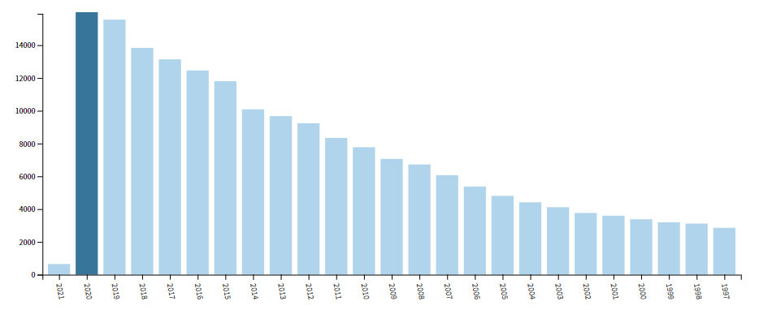
We now live in
Information age
Information explosion
Number of papers with topic as “ecology”
# of papers
Year
Present

Slide 4
How to search？ Critical steps
1
Define research question
2
Select search resources
3
6
4
5
Choose search terms
Compile search strategy & execute search
Review results & revise search
Screen papers & organize information
Notes:
Define research question
Select search resources
Choose search terms
Compile search strategy & execute search
Review results & revise search
Screen papers & organize information

Slide 5
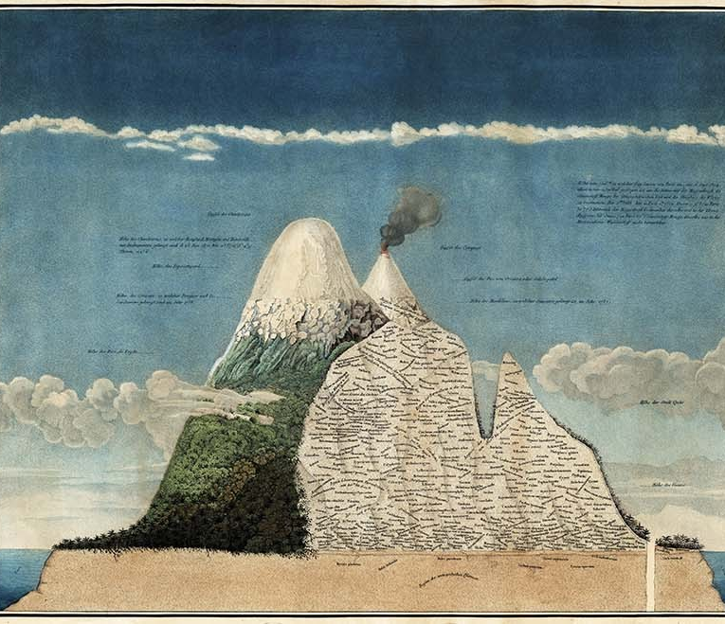
First thing: what is your research questions？
Elevational biodiversity gradients

Slide 6
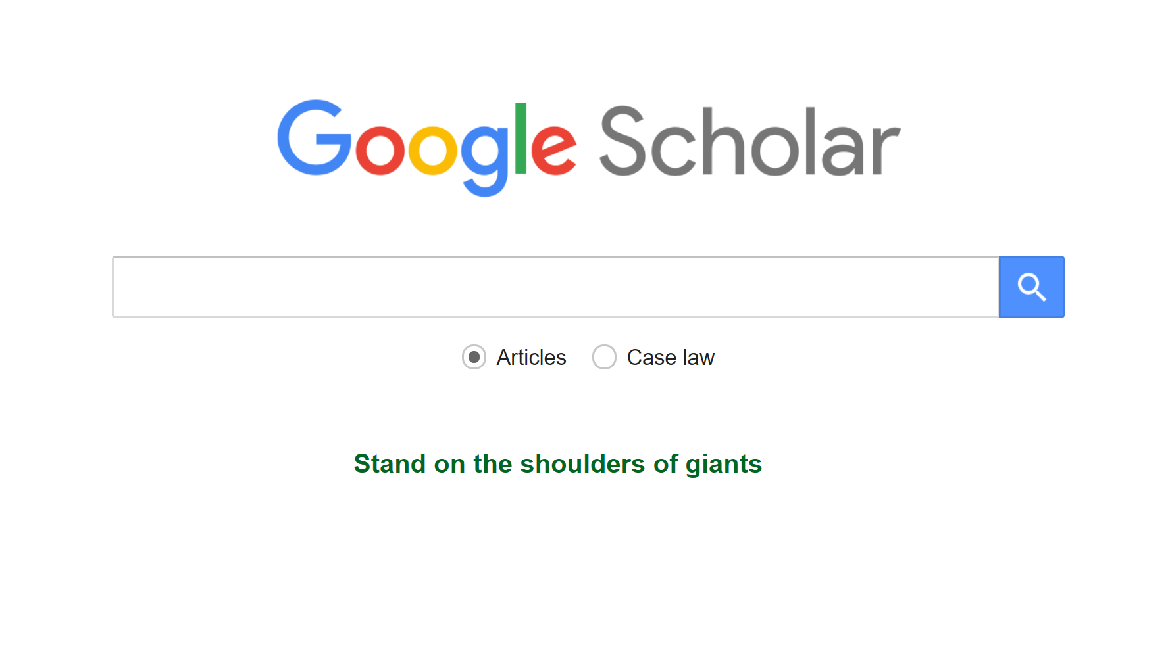
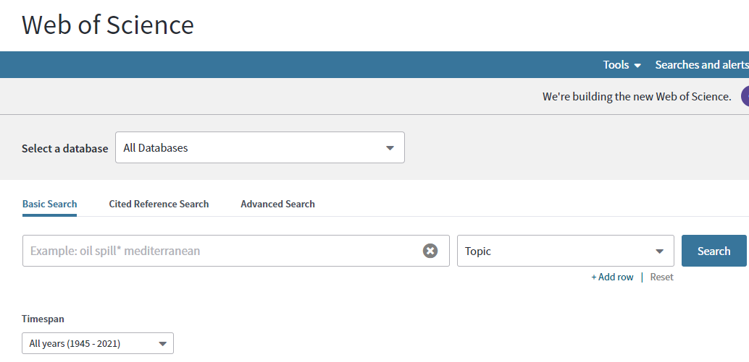
Search resources
Google Scholar (https://scholar.google.com/)
Web of Science (https://apps.webofknowledge.com)
a web search engine for scholarly literature across an array of publishing formats and disciplines.
a website that provide comprehensive citation data for many different academic disciplines.
Notes:
Google Scholar is a freely accessible web search engine that indexes the full text or metadata of scholarly literature across an array of publishing formats and disciplines.
Web of Science (previously known as Web of Knowledge) is a website that provides subscription-based access to multiple databases that provide comprehensive citation data for many different academic disciplines.

Slide 7
Choose search terms or key words
The most important part to find relevant literature
Do a broad literature search first to get a quick overview of the topic
Group your search terms
PECO framework
Search triangle
Category | Terms
Population | Species, plants…
Exposure | Elevation…
Comparator | Not applicable
Outcome | Biodiversity, richness..
Main subject
Biodiversity…
Limiters
Plants
abundance
Area of focus
Elevation…
from AUStudypedia
Notes:
Do a broad literature search first to get a quick overview of the topic you want to examine in connection with your research question.
Strategy, three angle (blocks)
Relavant, Narrow, broad keywords,
*, ?, phrase
Elevation gradients

Slide 8
Relevant keywords
Consider which relevant terms you should include to make your search as complete as possible
Broader terms: richness – biodiversity…
Narrower terms: species – plants, birds…
Synonyms: elevation – altitude…
Notes:
alpha diversity

Slide 9
Truncation, wild card & phrase search
Truncation (e.g. *) used to search different word endings
e.g. use comput* to find computer, computers, computed, computing, tect
Wild Cards (e.g. ?) used to search for spelling variants
e.g. use colo?r to find color and colour
Phrase search (“ ”) used to search for precisely the text you have written
e.g. “species richness”
Notes:
Truncation refers to the use of wildcard symbols, e.g. * or ?. Truncation symbols replace one or more letters and are most often placed at the end of your keywords. They can however also be placed in the middle of a keyword or, in some databases, at the beginning of a keyword.
Masking is a specific form of truncation where you replace one single letter in a keyword with a masking symbol. Masking is usually used in the middle of a keyword:
Phrase search is used when you want to ensure the database searches for precisely the text you have written. You can do this by placing one or more words in quotation marks. Phrase search is particularly good for composite terms.

Slide 10
Search terms for elevational biodiversity gradients
elevation*, altitude*
diversity, biodiversity, richness, “number of species”, “alpha diversity”, “alpha-diversity”, “α-diversity”, “α diversity”, “beta diversity”, “beta-diversity”, “β-diversity”, “β diversity”
species, plant*, bird*, amphibian*, mammal*, reptile*, butterfl*, ant*, insect*, arthropod*…
abundance, density
Notes:
species richness, gradient, mountain, elevation, altitude, abundance, alpine, diversity

Slide 11
Search strategy – Boolean operator
OR: use to combine terms within the same concept
AND: use to combine together different concepts
NOT: use to exclude terms from your search
OR
AND
NOT
A
B
A
B
A
B
A OR B
A AND B
A NOT B
Notes:
You can state the relationship between your search words by using the so-called Boolean operators. These operators are the three words: “and”, “or”, and “not”.
And – finds the results in which both words occur: Learning AND education
Or – finds the results in which only one of the words occurs: Learning OR education
Not – finds the results in which the first word occurs but not the second one: Learning NOT education.

Slide 12
More than two words
A
B
A
B
C
C
(A AND B) OR C
A AND (B OR C)
When more than two terms are combined with different boolean operators, use parenthesis to group or nest terms

Slide 13
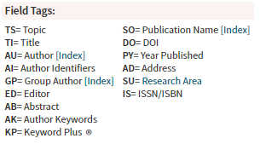
Strategy for our class project
TI = (elevation* OR altitud*) AND AK = (biodiversity OR diversity OR richness* OR “number of species” OR “alpha diversity” OR “alpha-diversity” OR “α-diversity” OR “α diversity” OR “beta diversity” OR “beta-diversity” OR “β-diversity” OR “β diversity”) AND AB = (species OR plant* OR bird* OR amphibian* OR mammal* OR reptile* OR butterfl* OR ant* OR insect* OR arthropod*) AND AB = (abundance* OR (density NOT “species density”))
Notes:
TI = (elevation* OR altitud*) AND AK = (species OR plant* OR bird* OR amphibian* OR mammal* OR reptile* OR butterfl* OR ant* OR insect* OR arthropod* ) AND AB = (biodiversity OR diversity OR richness* OR “number of species” OR “alpha diversity” OR “alpha-diversity” OR “α-diversity” OR “α diversity” OR “beta diversity” OR “beta-diversity” OR “β-diversity” OR “β diversity”) AND AB =(abundance* OR (density NOT “species density”))

Slide 14
Refine your searches
too few results
too many results
the wrong results
Check your search words for spelling or typing mistakes
Check whether you have used “and”, “or”, or “not” correctly
Truncate your search words
Find more synonyms for your search words
Search using fewer search words
Search in other databases.
Search for your selected narrow terms
Check whether you have used “and”, “or”, and “not” correctly
Use quotation marks around a sentence to search precisely for the combined content
Decide whether you have truncated your search words so much that you might also be searching for words outside your field of interest
Check whether some of your search words might have a different meaning than the intended meaning
Search in other databases.

Slide 15
Delimitations
Which languages am I looking for?
Is there a geographical scope for my searches?
Am I interested in a specific, limited period of time?
Articles, comments, or reviews?

Slide 16
Reproducibility – keep a record of your search
Which databases you searched in.
The words you have searched for - and how (e.g. use of truncation, limiting to specific search fields).
Limiting to a particular language, publication type, year, etc.
The search result (number of references).
The date for when you performed each search.

Slide 17
Other search approaches – citation index
Older literature: check references of a specific relevant article
Newer literature: use the information about which later articles cite a specific relevant article.
Class project: references of meta-analyses and reviews

Slide 18
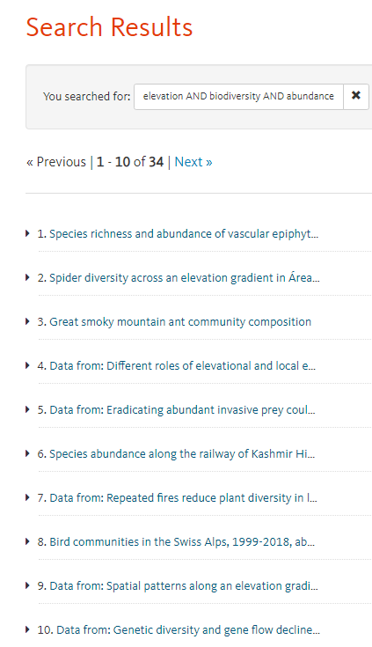
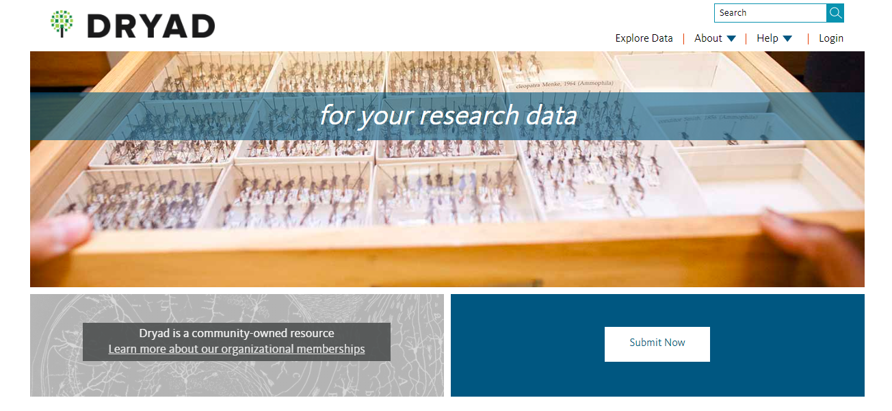
Search in repository of research data
https://datadryad.org/
Notes:
Dryad is an international open-access repository of research data, especially data underlying scientific and medical publications (mainly of evolutionary, genetic, and ecology biology). Dryad is a curated general-purpose repository that makes data discoverable, freely reusable, and citable.
Figshare is an online open access repository where researchers can preserve and share their research outputs, including figures, datasets, images, and videos.
(elevation OR altitude) AND (biodiversity OR diversity OR richness OR alpha diversity OR beta diversity) AND (species OR plant OR bird OR amphibian OR mammal OR reptile OR butterfl OR ant OR insect OR arthropod) AND (abundance OR density)
elevation AND biodiversity AND abundance

Slide 19


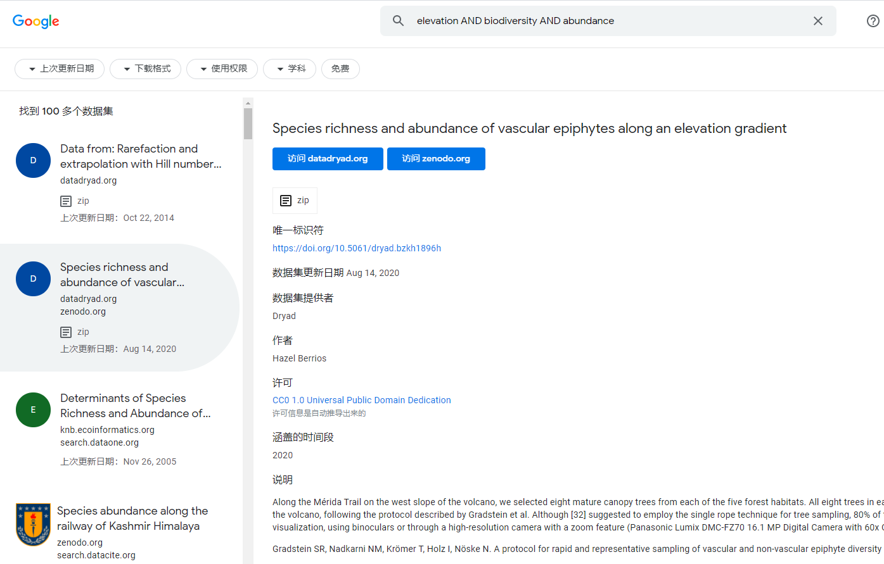
https://datasetsearch.research.google.com/

Slide 20
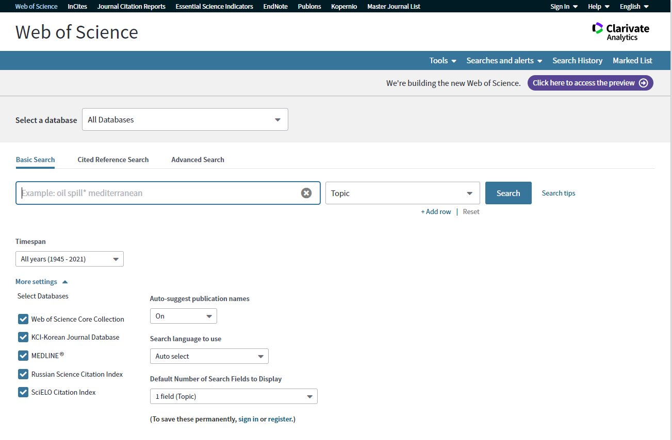
Web of science

Slide 21
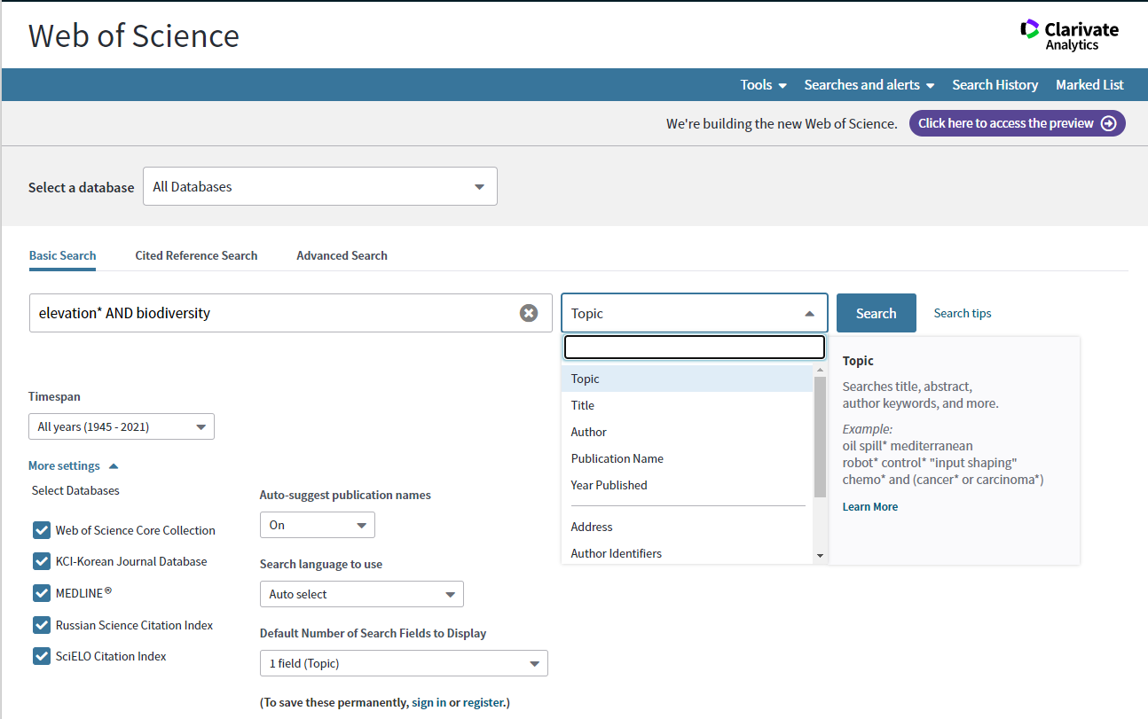

Slide 22
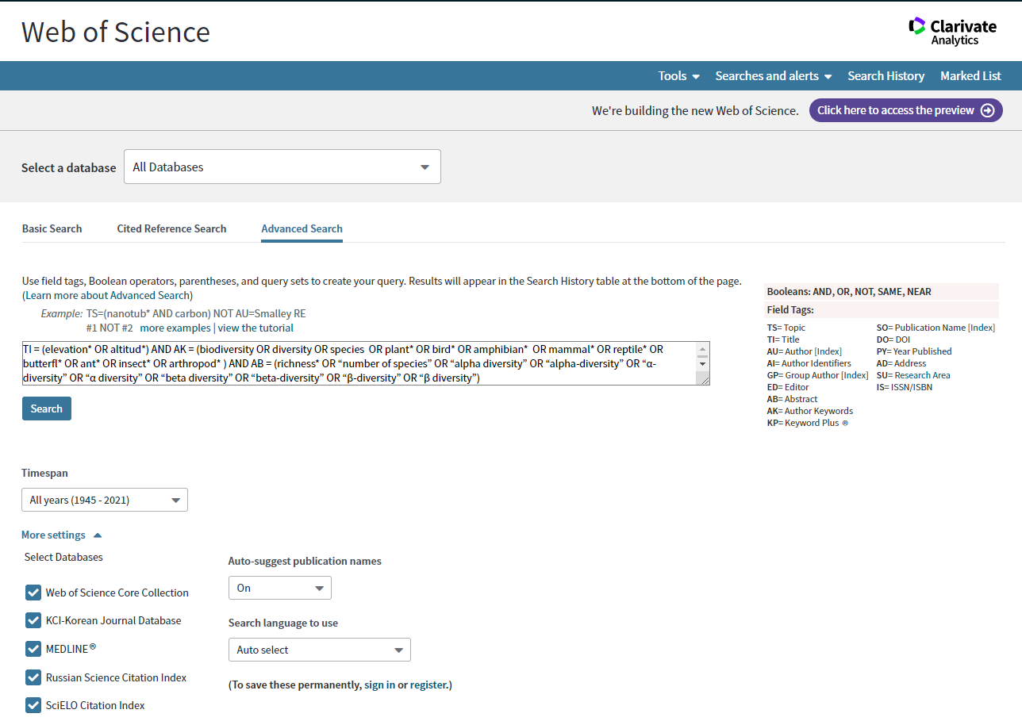

Slide 23
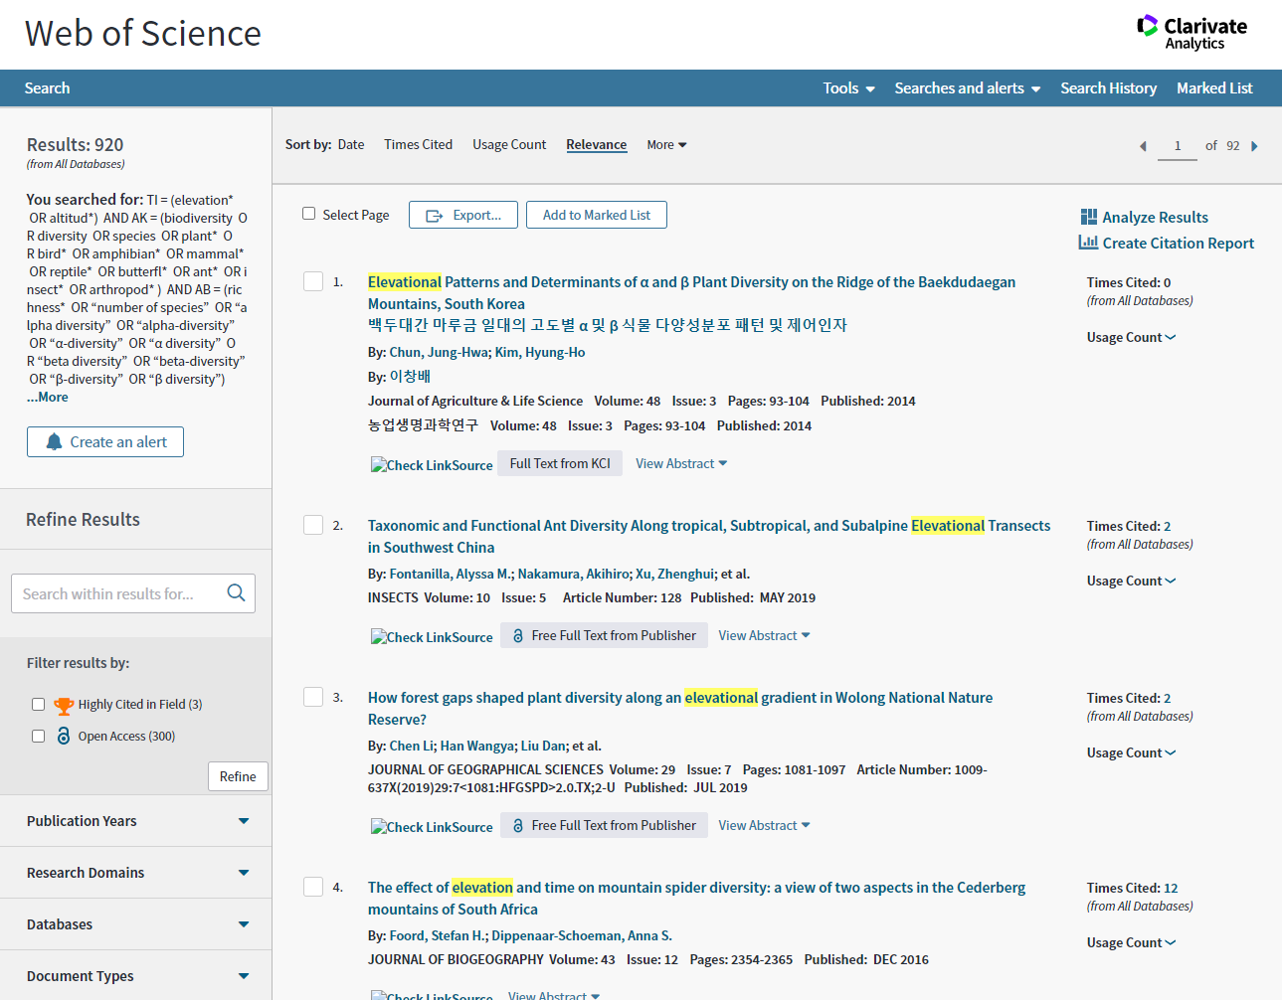
number of papers
Sort by data, times cited, relevance etc.
filters

Slide 24
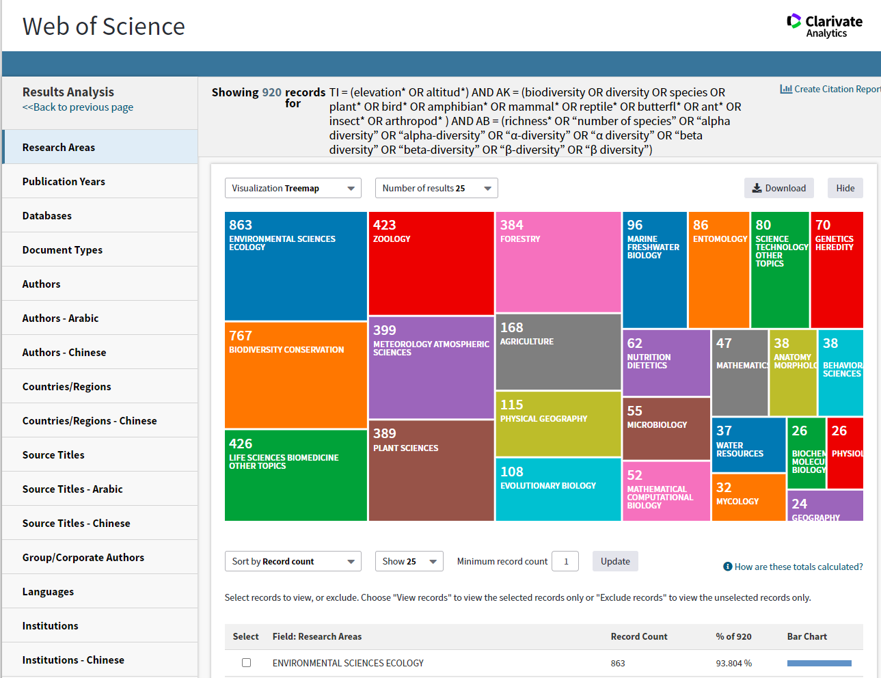
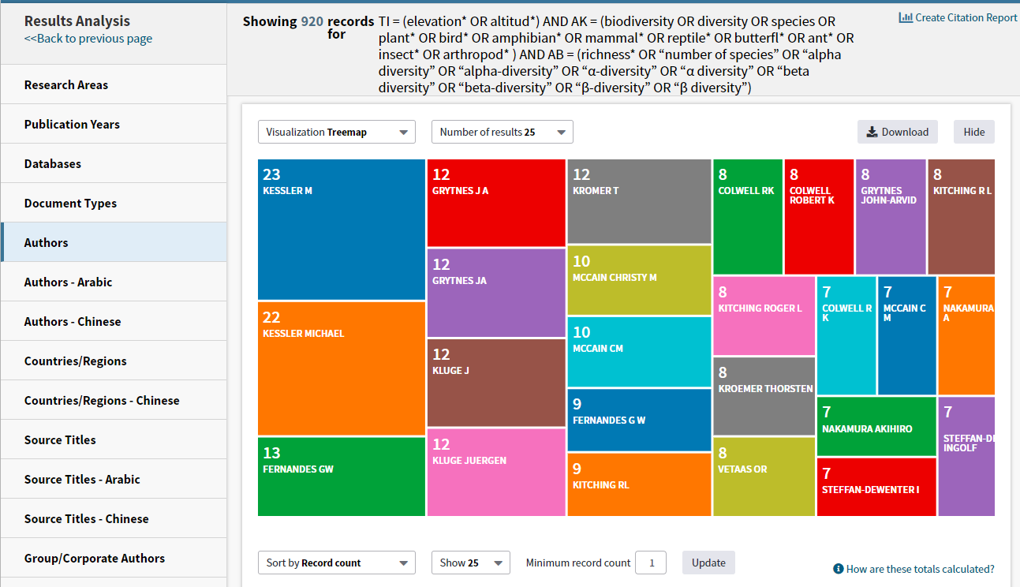
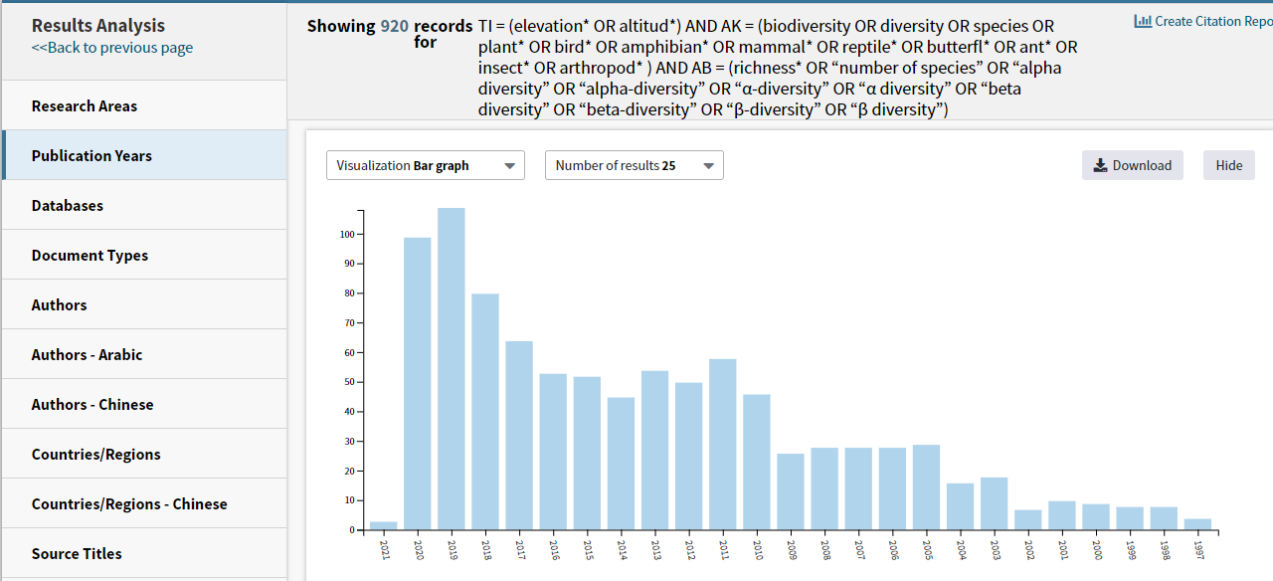

Slide 25
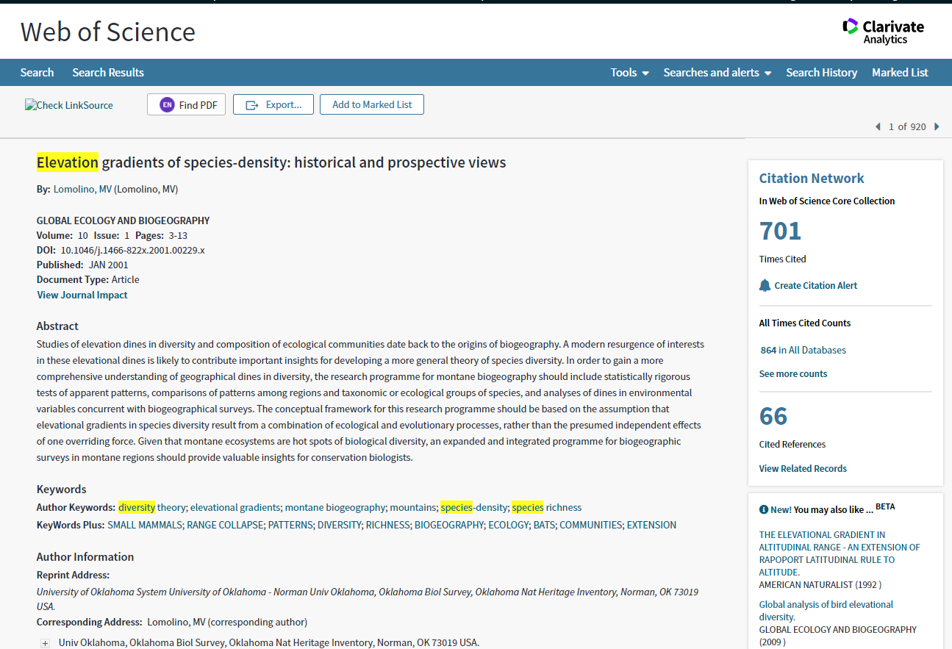
Find the full text
Title
Abstract to help you decide whether you read the full text
Author keywords to help to revise search terms

Slide 26
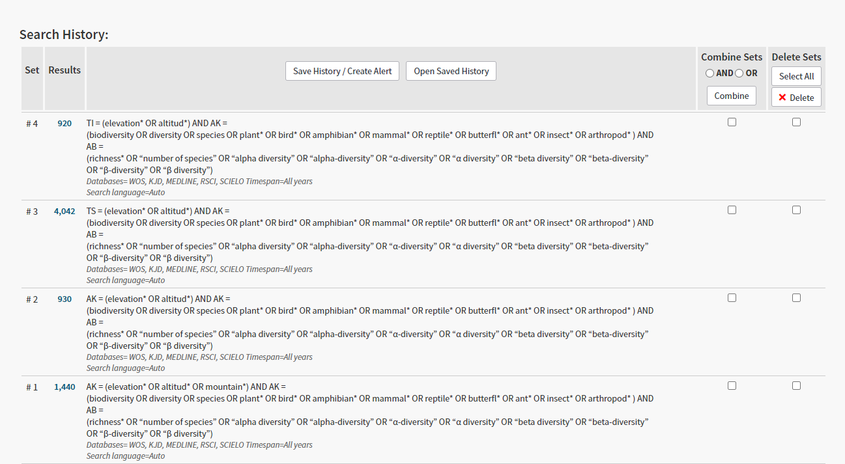
Compare results from different searches

Slide 27
Our task
Conduct a literature search for the class project
The purpose is to find papers with raw abundance data
Discuss and compare results with different terms and strategies
Determine final terms and strategy
Screen papers to determine potentially useful papers (assignment)
Download full text to find raw datasets
Search datasets in the repository of research data

Slide 28
Thank you very much!
Questions?

